Slide 1
Probable Reasons of Loan Defaulting
By Kishan Patel

Slide 2
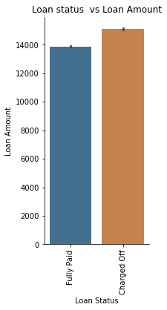
Loan Data: 2007-2016
Loans Given Out: 396030
Loan Amount Ranges:
<20k - >=10k 40.30
<10k - >=5k 24.66
<30k - >=20k 18.27
<5k - >=1k 9.84
>=30K 6.91
<1k 0.002
Number of
Bankruptcies Reported:
<2 99.41
<3 - >=2 0.46
<4 - >=3 0.08
<5 - >=4 0.02
>=5 0.01

Slide 3
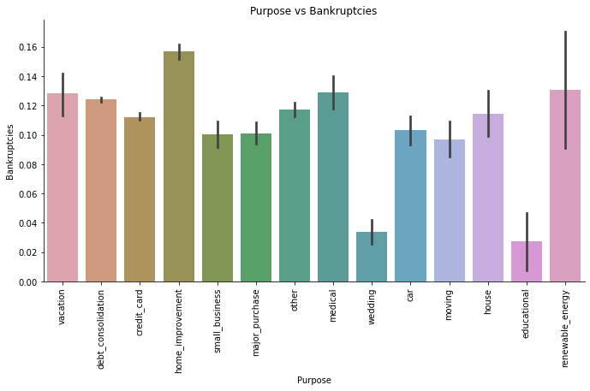
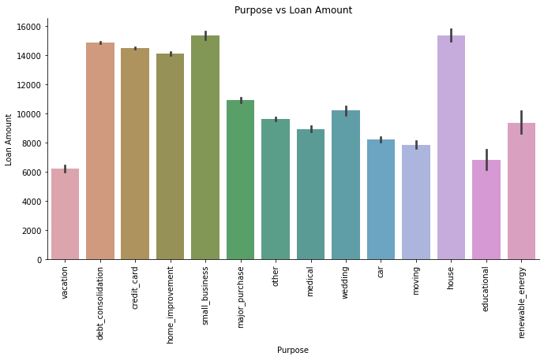
Purpose of Taking Out Loan
Loans taken out:
-High amount- House, small business, debt, credit card, home improvement
-Low amount- Vacation, education
-Bankrupt- highest home improvement, medical, renewable energy, vacation, debt.

Slide 4
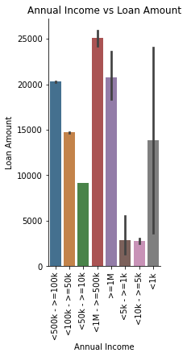
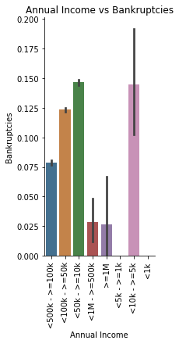
Annual Income
-Most loans were by people with and annual income of <1M -500k, followed by >=1M, <500k-100k.
-Least loans were with people with annual income of <10k- 1k which was also shown to have a high bankruptcy reporting, followed by people who made <50k - >10k followed by <100k - >=50k.

Slide 5
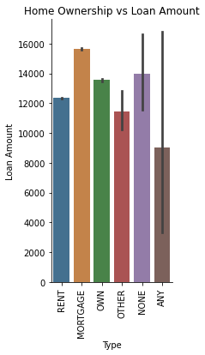
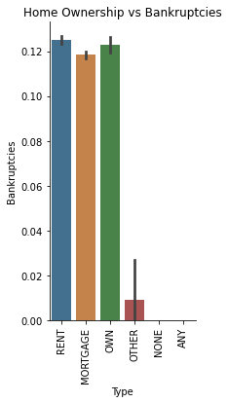
Home Ownership
People took out the most loans had a mortgage, followed by owning a house then renting.
-All 3 of these had nearly an equal amount of bankruptcies with people who rented highest.

Slide 6
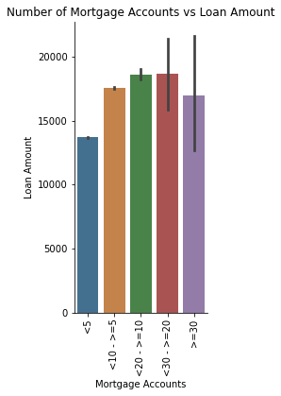
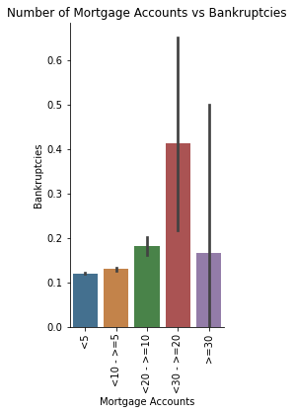
Number of Mortgage Accounts
-People who had <30->=20 accounts had the highest bankruptcies.

Slide 7
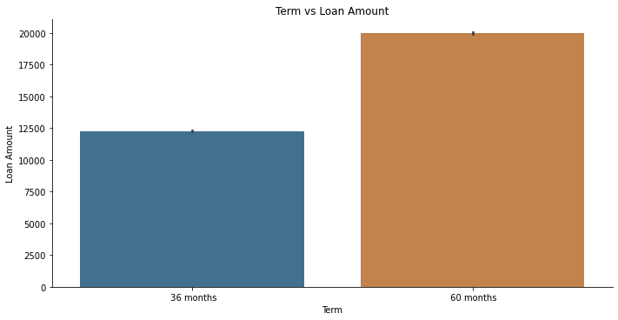
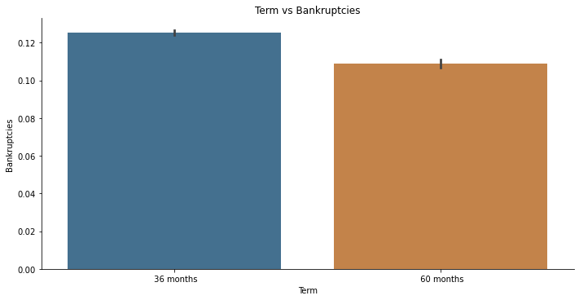
Term Length
More loans are taken out for 60 months but bankruptcies happen a bit more with 36 month plan types.

Slide 8
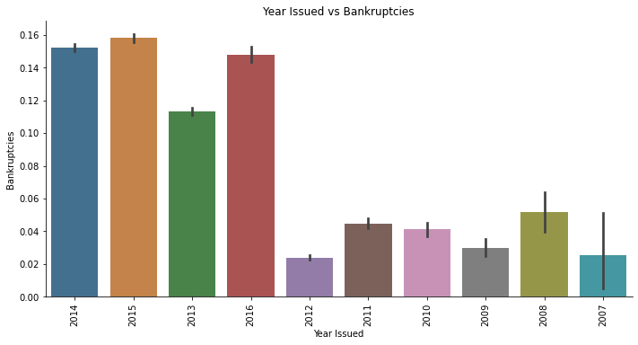
Issue Year
-Younger the loan, more bankruptcies exist.
-There were more bankruptcies starting in Year 2013 and highest in year 2015 and lowest in year 2012.

Slide 9
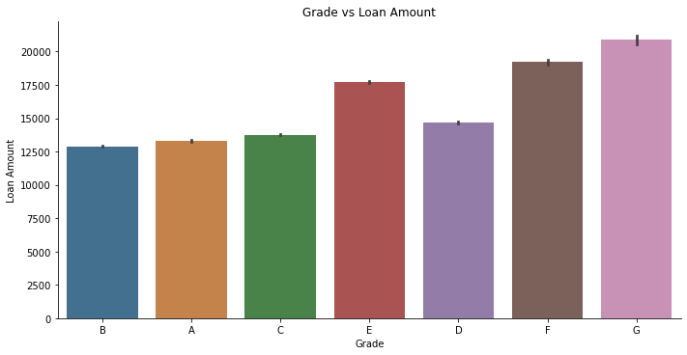
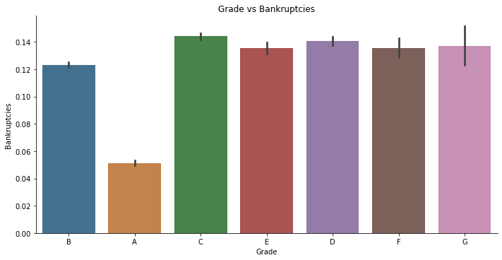
Grade
A-G
https://www.lendingclub.com/foliofn/rateDetail.action
Classification system that involves assigning a quality score to a loan based on a borrower's credit history, quality of the collateral, and the likelihood of repayment of the principal and interest.
-Lower the grade, Higher the risk and Interest and risk.

Slide 10
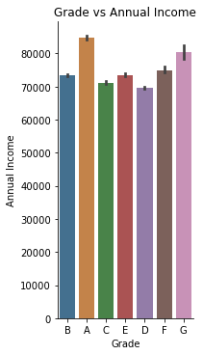
Grade Cont.
-Grade A had the least amount of defaulting (highest annual income).
-D and C and the lowest annual income. Maybe not give out loans to these people.

Slide 11
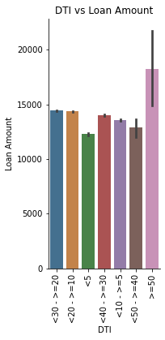
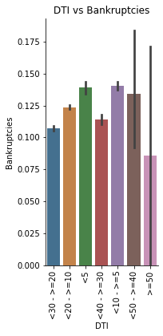
DTI
Debt-to-income ratio
Percentage of your gross monthly income (before taxes) that goes towards payments for rent, mortgage, credit cards, or other debt.
- People with DTI >=50% had less bankruptcies.

Slide 12
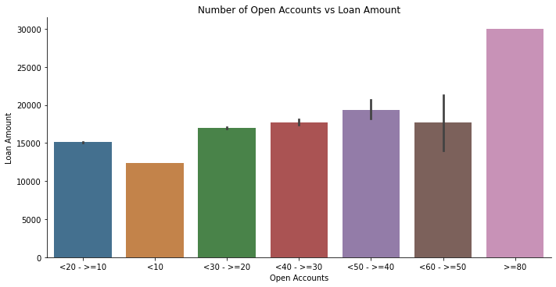
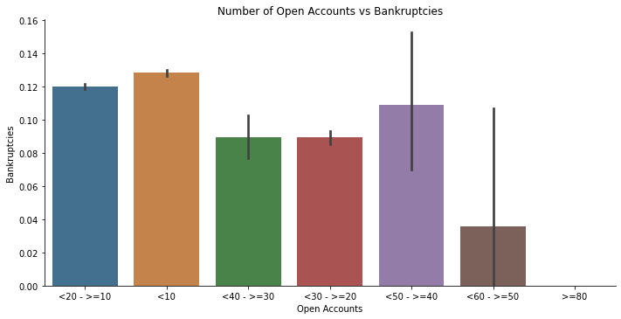
Number of Open Accounts
-Highest >=80 accounts
lowest <10
-Bankruptcies more likely with <10-<20 and <50-40 accounts.

Slide 13
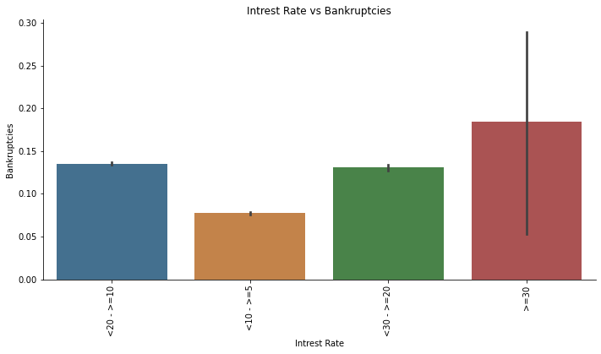
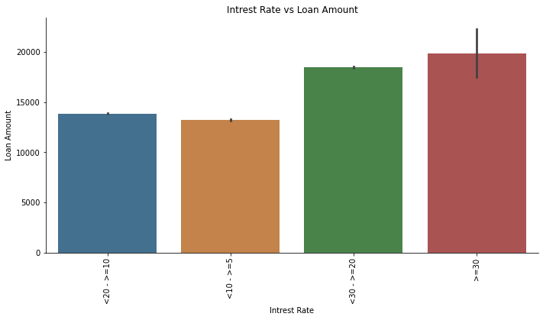
Interest Rate
-There were more loans that had an interest rate of >=20%.
-Higher the interest rate, higher the risk of defaulting.

Slide 14
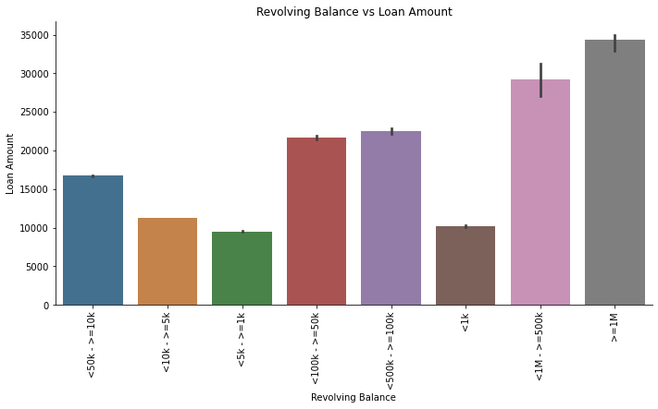
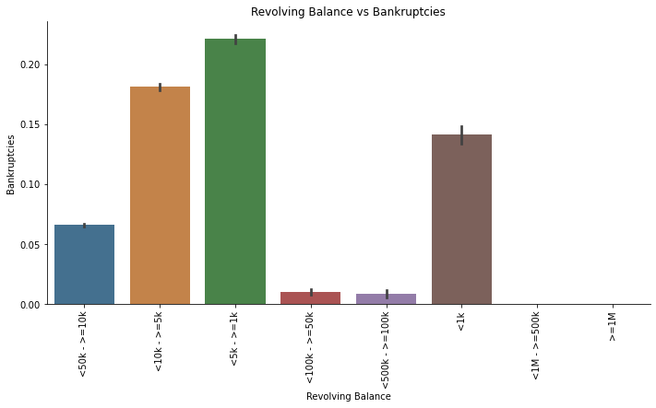
Revolving Balance
-Unpaid portion carries over to the next month.
<1k-<10k rage was the least amount given out, but the most amount that experienced bankruptcies.

Slide 15
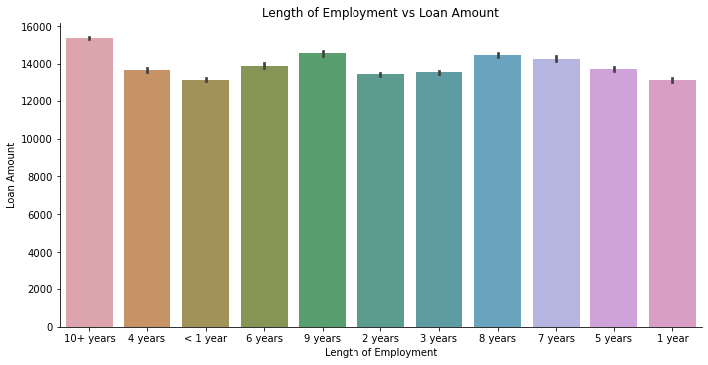
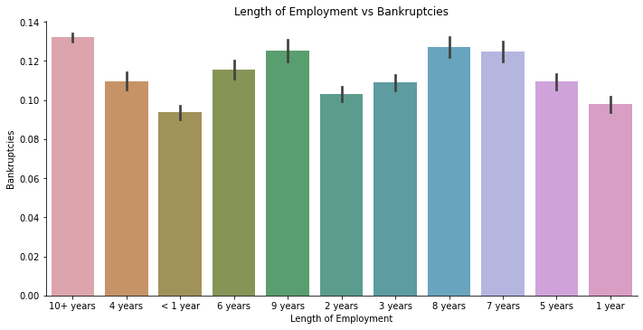
Employment Length
-Length of Employment didn’t affect
defaulting

Slide 16
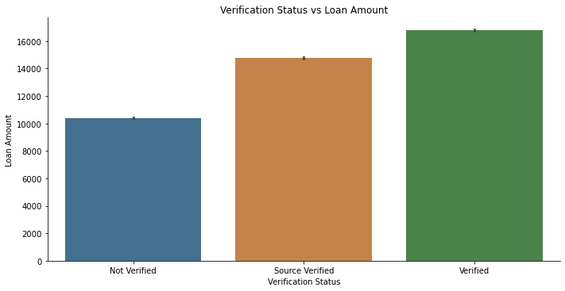
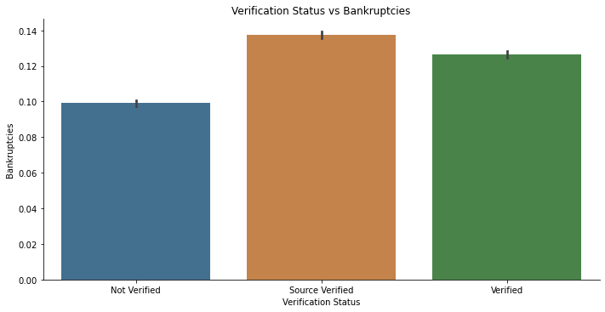
Verification
-Verification does not affect defaulting much.

Slide 17
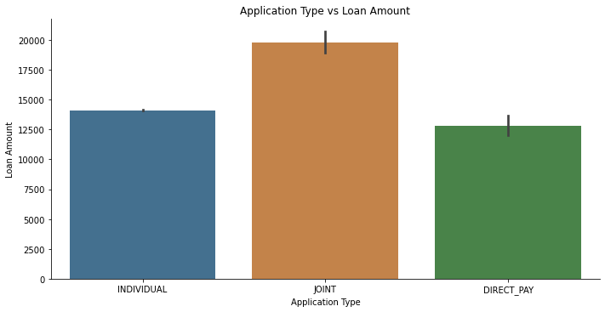
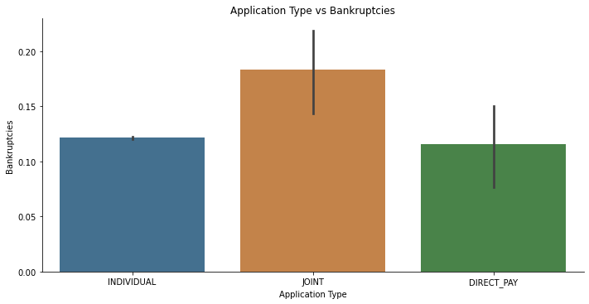
Application Type
-Application Type did not affect defaulting

Slide 18
Summary
Employment Length, Verification, Application Type did not affect loan repayment.
Purpose, Annual Income, Home Ownership, Number of Mortgage Accounts, Term Length, Issue Year, Grade, Number of Accounts Open, Interest Rate, DTI, Revolving Balance affected loan repayment

Slide 19
Summary Cont.
Purpose- Avoid clients that request for home improvement, medical, renewable energy, vacation, and debt.
Annual Income- Avoid clients who request loans with annual income of <50k- >=5k.
Home Ownership- Avoid clients who request loans to Rent lodging.
Mortgage Accounts- Avoid clients who had <30->=20 mortgage accounts
Term Length – Give out more 60 month loans
Issue Year- Not changeable.

Slide 20
Summary Cont.
Grade- Offer more to clients of Grade A status and less to C-G.
Open Accounts- Monitor more on accounts <10-<20 and <50-40 accounts.
Interest Rate- Lower interest rate.
Revolving Balance- Avoid people with range of <1k-<10k range revolving balance.
DTI- market to people with DTI >=50% and avoid people with DTI of <5-<10.

